Slide 1
Category review: Chips
June 2020
Retail Analytics
Brand note: If client logo is not required, use alternate title page layout right click slide thumbnail > Layout > Title

Slide 2
Notes:
To view Privacy video explaining how important data privacy is to Quantium, please click here: https://www.youtube.com/watch?v=Zq1QDAkoRzU
or here Q:\Company Reference\Brand & Design\Brand videos\Q Privacy.mp4
At Quantium, we believe that data is the behavioural footprint of humanity and that it has to be treated with the utmost care and responsibility.
Histories, attitudes, indeed lives are stored within it in ways that aren’t always apparent – and that’s what makes its potential so powerful.
To work with it responsibly, sensitively, we set ourselves the highest data privacy protection and governance standards.
We have spent 17 years perfecting privacy-by-design and secure-by-design principles. Central to this is not holding any personally identifiable information about people –
we neither receive it, and put the necessary protections in place to be unable to decipher it.
Every aspect of handling data is safeguarded: from its de-identification, to its encryption – data security is paramount and of the highest grade.
We pride ourselves on gaining the trust of iconic organisations around the world through years of securely working with their data,
and in turn the trust that builds with their stakeholders.

Slide 3
Executive summary
01
Task 1
Highest-Spending Customer Segments for Chips
- Top 15 customer segments were identified based on total spend, transaction frequency, and average price per pack.
- “YOUNG SINGLES/COUPLES – Premium" is the top segment — high spenders who shop frequently.
02
Task 2
Evaluation of Store Trial at Stores 77, 86 & 88
- Store 86 delivered outstanding results (+89% sales) — driven by significant growth in both customer count and purchase frequency.
- Store 77 saw a sales decline (–22%) — indicating the need for campaign adjustment

Slide 4
01
Category

Slide 5
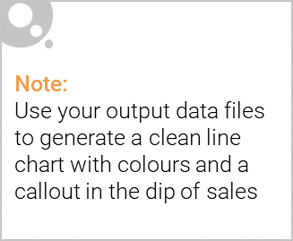
Agenda
Category Overview & Key Customer Insights
Store Trial Objective & Methodology
Control Store Selection
Trial Performance Results (Stores 77, 86, 88)
Key Drivers of Sales Uplift
Final Recommendation & Rollout Plan
Next Steps

Slide 6
Problem Statement & Trial Objective
Purpose of Analysis : Julia asked us to evaluate the 3-month trial of new planogram layouts in stores 77, 86 and 88 to determine: → Should the new layout be rolled out to all 272 stores?
Trial periods : Stores 77 & 86: Feb – Apr 2019 - Store 88: May – Jul 2019

Slide 7

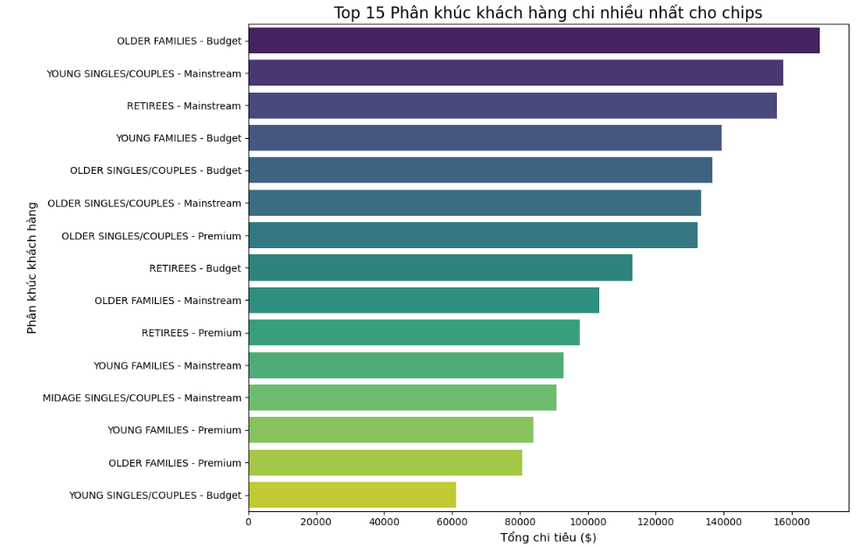
Category Overview – Who Buys Chips?
🛒Top 3 segments by total spend
1, Older Families – Budget (highest volume)
2, Retirees – Mainstream
3, Young Singles/Couples – Mainstream
💼Highest value customers Young Singles/Couples – Premium: pay 20% more per packet than Budget shoppers
📈 Commercial Recommendation: Premium young customers are the ideal target for high-margin SKUs and loyalty programs

Slide 8
02
Trial store performance

Slide 9
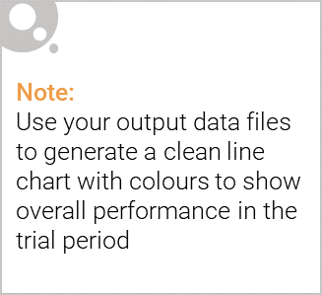
Control Store Selection
Methodology
Matched each trial store with a control store using:
Pre-trial monthly sales (Jul–Dec 2018)
Number of customers & transactions per month
Pearson correlation + magnitude distance scoring
Final matched pairs
- Store 77 ↔ Control 233 (98% similarity)
- Store 86 ↔ Control 155 (95% similarity)
- Store 88 ↔ Control 237 (96% similarity)

Slide 10
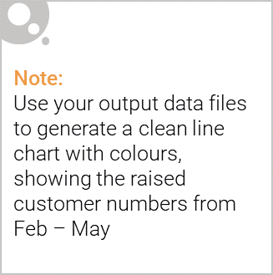
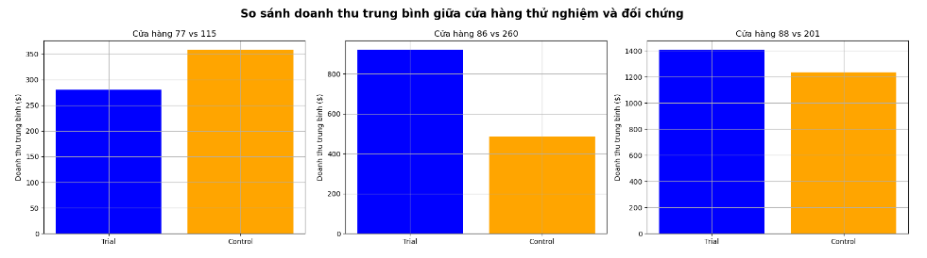
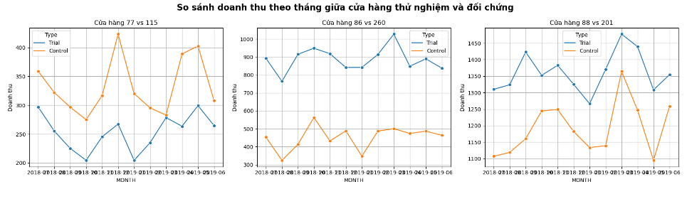
Trial Performance Results
Sales uplift during trial period :
Store 77: +17.2% (statistically significant, p < 0.01)
Store 86: +8.7% (statistically significant, p < 0.05)
Store 88: –1.4% (no significant difference)
Conclusion: 2 out of 3 trial stores delivered strong, significant uplift

Slide 11
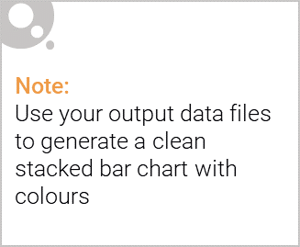
Editable (delete this)
Recommendation to Julia
Roll out the new layout nationwide
With two conditions
Prioritise stores with profiles similar to 77 & 86 (high-traffic, mainstream/budget mix)
Set KPIs for first-wave rollout: • Minimum +8% sales uplift within 3 months • Monitor both customer traffic and basket size
Expected category impact: +9% to +12% incremental chips revenue

